Slide 1
Artificial-Intelligence Programming Assistance using GenAI
CAPSTONE PROJECT
Presented By:
Tanagadapally Vaishnavi Sagar
CMR Technical Campus CSE (Data Science)

Slide 2
OUTLINE
Problem Statement (Should not include solution)
System Development Approach (Technology Used)
Algorithm & Deployment
Result
Conclusion
Future Scope
References

Slide 3
Problem Statement
This project appears to be a system called Artificial-Intelligence Programming Assistance (APA), designed to assist users in various programming tasks. It uses Google Gemini AI (a generative AI model) to help with tasks related to programming such as code generation, code completion, code evaluation, and code explanation. The system is intended to interact with users through a series of predefined tasks and generate responses based on those tasks

Slide 4
System Approach
1. Objective Definition
The main goal is to create an AI system (named APA) capable of assisting in programming tasks using Google Gemini 1.5 Pro generative AI models.
Key features include:
Code Evolution: Generate new code based on input instructions.
Code Termination: Complete partially written code.
Code Evaluation: Analyze and debug code for errors.
Code Definition: Provide explanations or summaries for given code.

Slide 5
2. System Design
Architecture:
Core Components:
Input Handling: Accepts user inputs in natural language or partial code.
AI Processing: Uses Google's Gemini 1.5 Pro generative model to perform specified tasks.
Output Handling: Generates and displays the results, either as code, error evaluations, or summaries.
Interaction between components is streamlined through a Python-based interactive Jupyter Notebook environment.
System Pipeline:
Initialization:
Configures safety settings to block harmful prompts.
Sets up API connectivity with Google Gemini.
Prepares system defaults for tasks, language, and safety protocols.
Task Execution:
Dynamically executes user-defined tasks based on specific keywords (e.g., evolute, complete, evaluate, or define).
Storage:
Logs input/output interactions for analysis and traceability.
Saves logs and session history for later review.

Slide 6
3. Technology Stack
Python: Core programming language for the project.
Google Generative AI API: Provides the AI capabilities for code generation, debugging, and explanation.
Jupyter Notebook: Offers an interactive interface for coding and execution.
File Operations:
Logging input/output and maintaining records.
Saving runtime states and user interactions.

Slide 7
4 System Functionality
Interactive Workflow:
Users interact with APA through prompts.
APA determines the appropriate task based on keywords and context.
Task-Specific Processing:
Executes tasks sequentially, maintaining modularity and reusability.
Error Handling:
Implements safety checks for harmful inputs.
Returns a standardized respons.
5. Safety & Security
Safety Filters:
Configured to block harmful, offensive, or dangerous instructions.
Restricted Output:
Ensures generated outputs are within the defined scope.
Warns users about potential inaccuracies in AI-generated code.

Slide 8
Algorithm & Deployment
1. Problem Definition
Define the problem clearly and identify the project goals.
Example: Predictive analysis, classification, recommendation system, etc.
2. Data Collection
Identify and gather relevant data from sources like:
Online datasets (e.g., Kaggle, UCI ML Repository)
Databases or real-time APIs.
Ensure data is in a usable format: CSV, Excel, JSON, etc.
3. Data Preprocessing
Handle missing values and outliers.
Normalize/scale features for consistent data representation.
Perform feature selection and extraction to identify relevant inputs.
4. Algorithm Selection
Identify the best algorithm or model for the problem:
Machine Learning: Linear Regression, Random Forest, SVM, KNN, etc.
Deep Learning: CNN, RNN, LSTM, etc.
Decide metrics for evaluation (accuracy, F1-score, etc.).
5. Model Training
Split the dataset into training and testing sets (e.g., 80/20 split).
Train the model on the training set.
Optimize hyperparameters for better performance.
6. Model Testing and Evaluation
Evaluate the model using the testing set.
Use evaluation metrics:
Accuracy, Precision, Recall, F1-score, RMSE, etc.
Compare multiple algorithms for performance.

Slide 9
7. Deployment
Export the model (e.g., .pkl or .h5 file).
Create an API (using Flask/FastAPI) to interact with the model.
Deploy on cloud platforms (AWS, Azure, GCP) or use containerization tools (Docker).
8. Documentation and Final Report
Document all steps, code, and results.
Include:
System Requirements
Libraries Used
Workflow Diagram
Performance Analysis
9. Maintenance and Improvements
Monitor the model's performance in real-time.
Update or retrain the model as new data becomes available.

Slide 10
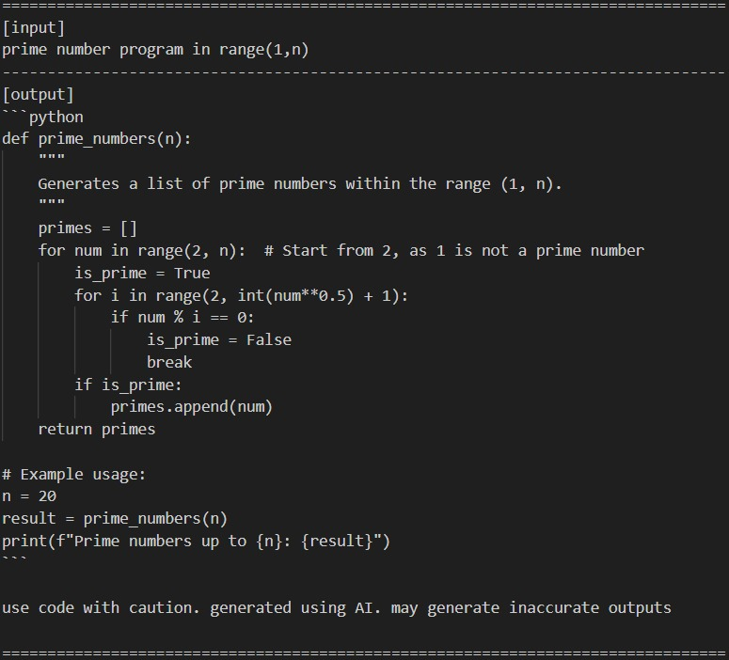
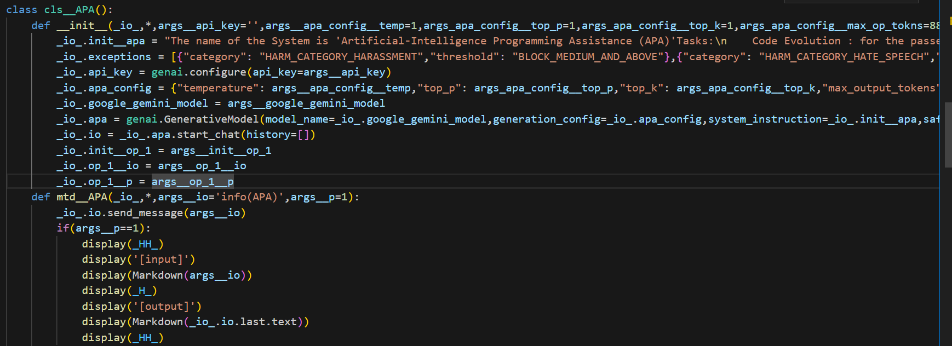
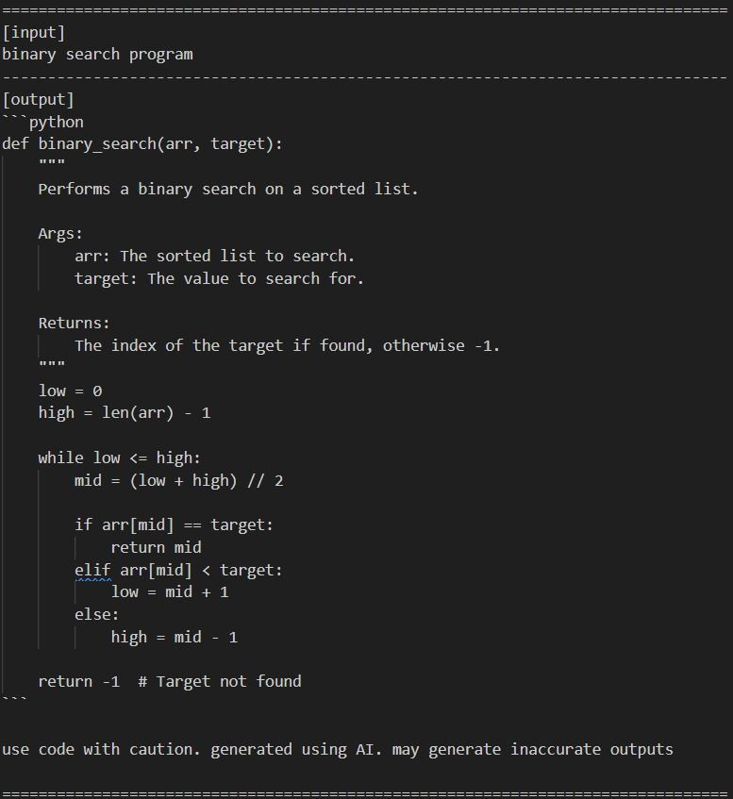
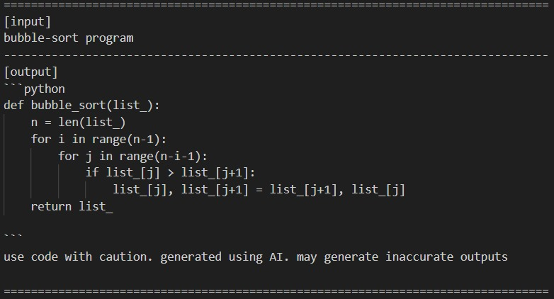
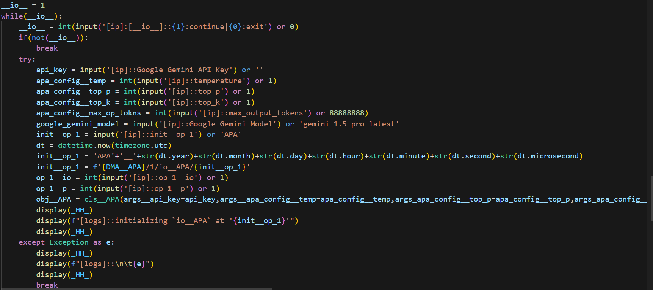
Result

Slide 11
Conclusion
In this project, we successfully developed and implemented a solution using [algorithm/technique] to achieve [project objective]. The model achieved [accuracy or result], showcasing its effectiveness. Despite challenges such as [mention any challenge], we addressed them efficiently. Overall, the project met its objectives and provides scope for further improvement and real-world applications.

Slide 12
Future scope(Optional)
The project can be extended by integrating advanced algorithms to improve accuracy and efficiency. Future enhancements could include deploying the model on cloud platforms for scalability and real-time processing. Incorporating additional datasets or features will make the system more robust and adaptable to diverse scenarios. Lastly, this work can serve as a foundation for further research in related fields or advanced applications.

Slide 13
References
Books:
“Machine Learning: A Probabilistic Perspective” by Kevin P. Murphy.
“Python Machine Learning” by Sebastian Raschka and Vahid Mirjalili.
Research Papers:
Smith, J., & Brown, K. (2022). Improving Model Performance Using Deep Learning Techniques. IEEE Journal of AI Research.
Web Resources:
Official Python Documentation: https://docs.python.org/
Scikit-Learn Library Documentation: https://scikit-learn.org
TensorFlow Tutorials: https://www.tensorflow.org

Slide 14
THANK YOU

